Slide 1
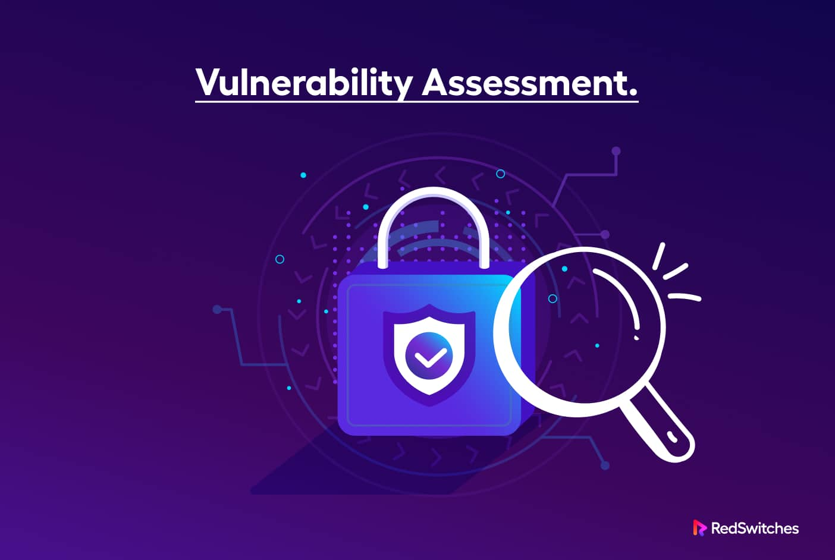
ESSENTIAL OF TELECOM SECURITY TESTING
19th June 2024
Vulnerability Assessment: Safeguarding Telcom Infrastructure
By MANAS KUMAR PANDA ADG(SAS-IV)

Slide 2
Vulnerability ?
Key to hack a system
A security vulnerability is a weakness, bug, or programming mistake in hardware or software that attackers can exploit to compromise your network and gain unauthorized access to your data and systems.
Weakness(CWE) vs Vulnerability(CVE)
While CVE identifies specific instances of vulnerabilities,
CWE categorizes the common flaws or weaknesses that
can lead to vulnerabilities.
Database by NIST: https://nvd.nist.gov/vuln

Slide 3
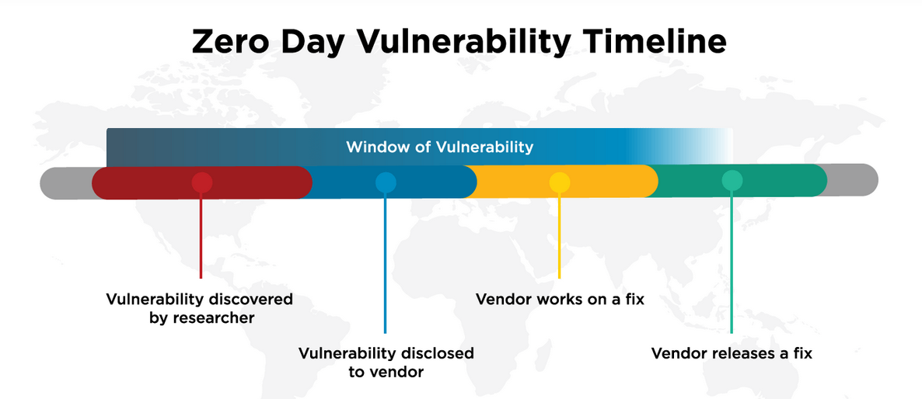
Vulnerability-Types
Unkown
known
Types:
Unknown:is dormant. It has not been discovered by anyone--Fuzzing
Zero-day:unveiled by one person or a team or organization.
Known:is published & patches are available---VA

Slide 4
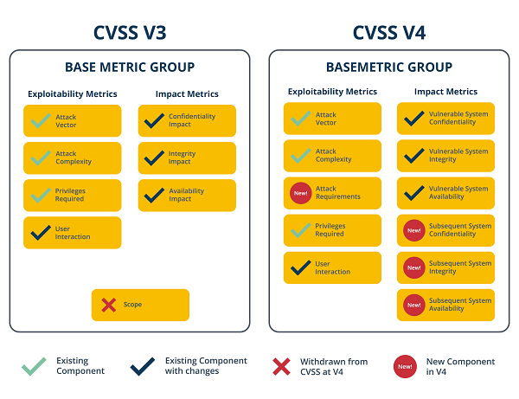
Vulnerability : Severity & Remediation
Common Vulnerability Scoring System (CVSS) provides a way to capture the principal characteristics of a vulnerability and produce a numerical score reflecting its severity. The numerical score can then be translated into a qualitative representation (such as low, medium, high, and critical) to help organizations properly assess and prioritize their vulnerability management processes.
ITSAR Recommendation CVSS 3.0
Common Vulnerability Scoring System
https://www.first.org/cvss/

Slide 5
VA- Vulnerability Assesment
Vulnerability assessment is a process that identifies and evaluates network vulnerabilities by constantly scanning and monitoring your organization's entire attack surface for risks.
It is the first step in defending your network against vulnerabilities
To lessen the chance that attackers can exploit your network and gain unauthorized access to your systems and devices.
Usually a automated process- VA tool eg Nessus, Nexpose, OpenVAS

Slide 6
Types of Vulnerability Testing
1
2
3
Network Vulnerability Testing
Web Application Vulnerability Testing
Host-Based Vulnerability Testing
This type of testing focuses on assessing the vulnerabilities present in an organization's network infrastructure, including routers, switches, firewalls, and other network devices. It helps identify weaknesses that could allow unauthorized access, data breaches, or disruption of network services.
NESSUS
NEXPOSE
Web application vulnerability testing examines the security of web-based applications, identifying vulnerabilities such as SQL injections, cross-site scripting (XSS), and other common web application flaws. This helps protect against attacks that could disrupt critical web-based services.
BURPSUITE
NIKTO
ACUNETIX
Host-based vulnerability testing involves scanning individual servers, workstations, and other endpoints for vulnerabilities. This includes evaluating the security configurations, software versions, and potential misconfigurations that could leave these systems exposed to threats.
NESSUS
NEXPOSE

Slide 7
Authenticated vs Non-Authenticated Scan
Credentialed vs Non-credentialed Scan
Non-Authenticated Scan: Assessing the security of systems without system privileges/authentication. Non-credentialed scans enumerate a host's exposed ports, protocols, and services and identifies vulnerabilities and misconfigurations that could allow an attacker to compromise your network.
A credentialed scan, also known as an authenticated scan, provides a deeper insight than a non-credentialed scan. The scan uses credentials to log into systems and applications and can provide a definitive list of required patches and misconfigurations. Because a credentialed scan looks directly at the installed software, including at the version numbers, it can assess items such as: Identifying vulnerabilities in the software, Evaluating password policies, Checking anti-virus software & system configurations.

Slide 8
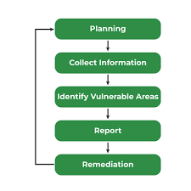
The Vulnerability Testing Process
1
Planning
The vulnerability testing process begins with careful planning. This involves defining the scope, objectives, and methodologies to be used, ensuring that the testing aligns with the organization's security goals and compliance requirements.
2
Discovery
The discovery phase involves the use of automated vulnerability scanning tools and manual testing techniques to identify potential security weaknesses across the IT infrastructure. This comprehensive assessment provides a detailed understanding of the organization's attack surface.
3
Analysis and Reporting
The identified vulnerabilities are then analyzed to understand their potential impact and prioritize them based on risk. A detailed report is generated, outlining the findings, their severity, and recommendations for remediation.

Slide 9
Vulnerability Assessment : Scan Process
Data Collection
Discovery
Port Scan
Unconfirmed Vulnerability Checks
OS Fingerprinting
Service Fingerprinting
Confirmed Vulnerability Checks
Policy Checks
Report Analysis

Slide 10
Vulnerability Assessment : Scan Process
1. DISCOVERY:
1
Discovery
2
Port Scan
DISCOVERY
3
Service Fingerprinting
OS Fingerprinting
4
Asset Discovery involves determining if scan targets are alive or not.
Using ICMP Ping
ARP Ping
TCP and/or UDP Ping
Unconfirmed vulnerability Checks
5
Confirmed vulnerability Checks
6
7
Policy Checks
Notes:
ARP ping operation reports the MAC address of the remote host and indicates that that IP address is active and reachable on the local network.
Ping a host using TCP. (many built in ports)-send a TCP packet/UDP packets to selected ports
https://docs.tenable.com/nessus/Content/DiscoverySettings.htm
https://community.tenable.com/s/article/What-ports-does-built-in-represent?language=en_US&_gl=1*au4yq4*_gcl_au*MTUwNjQ5MjgwMS4xNzE4Nzc0NTE2*_ga*MTAyMzM5ODgyNC4xNzA0OTY0NDg4*_ga_HSJ1XWV6ND*MTcxODc4NDUxNi4xNy4xLjE3MTg3ODQ1MjguNDguMC4xNjcyNzAxMTMx

Slide 11
2. PORT SCAN:
1
1
Discovery
PORT SCAN
2
Port Scan
3
Service Fingerprinting
OS Fingerprinting
To identify the open ports-Use Nmap helper libraries or inbuilt scanner
Network Port Scanners: TCP Scan , SYN Scan & UDP Scan (limited ports or all 1-65535)
Local Port Enumerators:
SSH(Netstat): The scanner uses netstat to check for open ports from the local machine. It relies on the netstat command being available via an SSH connection to the target. This scan is intended for Linux-based systems and requires authentication credentials.
WMI (Netstat): The scanner uses netstat to determine open ports while performing a WMI-based scan. For Windows based Machine.
SNMP: For Cisco Routers
4
Unconfirmed vulnerability Checks
5
Confirmed vulnerability Checks
6
7
Policy Checks
Notes:
https://docs.tenable.com/nessus/Content/DiscoverySettings.htm#PSNetworkPortScanners

Slide 12
3. SERVICE FINGERPRINTING:
1
Discovery
SERVICE FINGERPRINTING
2
Port Scan
3
Service Fingerprinting
OS Fingerprinting
4
Service Fingerprinting
-> Service Discovery section includes settings that attempt to map each open port with the service that is running on that port.
-> Methods:
1) Banner Grabbing
2) IP Stack Analysis
-> Service Fingerprinting for customer configuration
1) Map custom port to service name
2) Default-service.properties
Unconfirmed vulnerability Checks
5
Confirmed vulnerability Checks
6
7
Policy Checks
Notes:
Service Discovery section includes settings that attempt to map each open port with the service that is running on that port.
Banner grabbing refers to the extraction of software banner information from either remote or local servers like web servers, FTP servers, and SSH servers
Port 80 (HTTP)
Port 21 (FTP)
Port 25 (SMTP)
Port 22 (SSH)
Port 443 (HTTPS)
Port 3306 (MySQL)
Among the most popular ones are:
Telnet
Wget
cURL
Nmap
NetCat

Slide 13
3. OS FINGERPRINTING:
1
Discovery
OS FINGERPRINTING
2
Port Scan
3
Service Fingerprinting
OS Fingerprinting
4
OS Fingerprinting using information collected from the previous scan stages the scan attempts to guess which operating system is running.
Matching fingerprints against data returned from various network place
Simple to extract useful information from web server banners , snmp system description fields.
Nmap –O: enable OS detection
Unconfirmed vulnerability Checks
5
Confirmed vulnerability Checks
6
7
Policy Checks
Notes:
using TCP/IP stack fingerprinting. Nmap sends a series of TCP and UDP packets to the remote host and examines practically every bit in the responses. After performing dozens of tests such as TCP ISN sampling, TCP options support and ordering, IP ID sampling, and the initial window size check, Nmap compares the results to its nmap-os-db database of more than 2,600 known OS fingerprints and prints out the OS details if there is a match.

Slide 14
Unconfirmed Vulnerability
Checks
Confirmed Vulnerability
Checks
1
Discovery
2
Port Scan
3
Service Fingerprinting
Unconfirmed Vulnerability Checks
Primarily include checks based on patch and version information. These checks determine that a version of software etc. is known to have an issue but does not confirm the specific issue exists. An example may be that a version of software ships with a default password. The check would determine that that version of software is present and may have default credentials even if the credentials have already been changed.
Confirmed Vulnerability Checks
OS Fingerprinting
4
Unconfirmed vulnerability Checks
5
Confirmed vulnerability Checks
A confirmed check may go a step further than our Unconfirmed Vulnerability check by specifying that a specific OS, Application, and specific version of each must be present before it tries to take an action to verify if a vulnerability exists. For the example where a vulnerable version of software is present that is known to ship with a known default password the check may attempt to login with those known credentials to verify if the credentials have been changed.
6
7
Policy Checks

Slide 15
Common Vulnerabilities and Risks
1
Outdated Software
2
Weak Passwords
Failing to regularly update software, firmware, and operating systems can leave systems exposed to known vulnerabilities that can be exploited by attackers.
The use of weak or default passwords can provide easy access for malicious actors, compromising the security of systems and applications.
3
Unpatched Vulnerabilities
4
Configuration Issues
Not applying security patches and updates in a timely manner can leave organizations vulnerable to exploits targeting known vulnerabilities.
Misconfigurations in servers, network devices, and applications can inadvertently create security weaknesses that can be leveraged by attackers.

Slide 16
Effective Vulnerability Management Practices
1. Regular Testing
2. Prioritization
Conducting vulnerability testing on a regular basis, such as quarterly or semi-annually, helps organizations stay ahead of emerging threats and ensure their security posture remains robust.
Focusing on the most critical vulnerabilities, based on factors like exploitability and potential impact, allows organizations to effectively allocate resources and address the most significant risks first.
3. Comprehensive Coverage
4. Training and Awareness
Ensuring that all aspects of the IT infrastructure, including networks, web applications, databases, and endpoints, are thoroughly tested for vulnerabilities is essential for maintaining a robust security posture.
Educating employees on the importance of security and their role in preventing and mitigating vulnerabilities can significantly enhance an organization's overall security posture.

Slide 17
THANK YOU
THANK YOU

Slide 18
DEMO Video
https://www.youtube.com/watch?v=cEMKm-k-Drs&list=PLOMx6Layn69iwMczrFcUstlHSQA4OJ4FC&index=4

